Slide 1
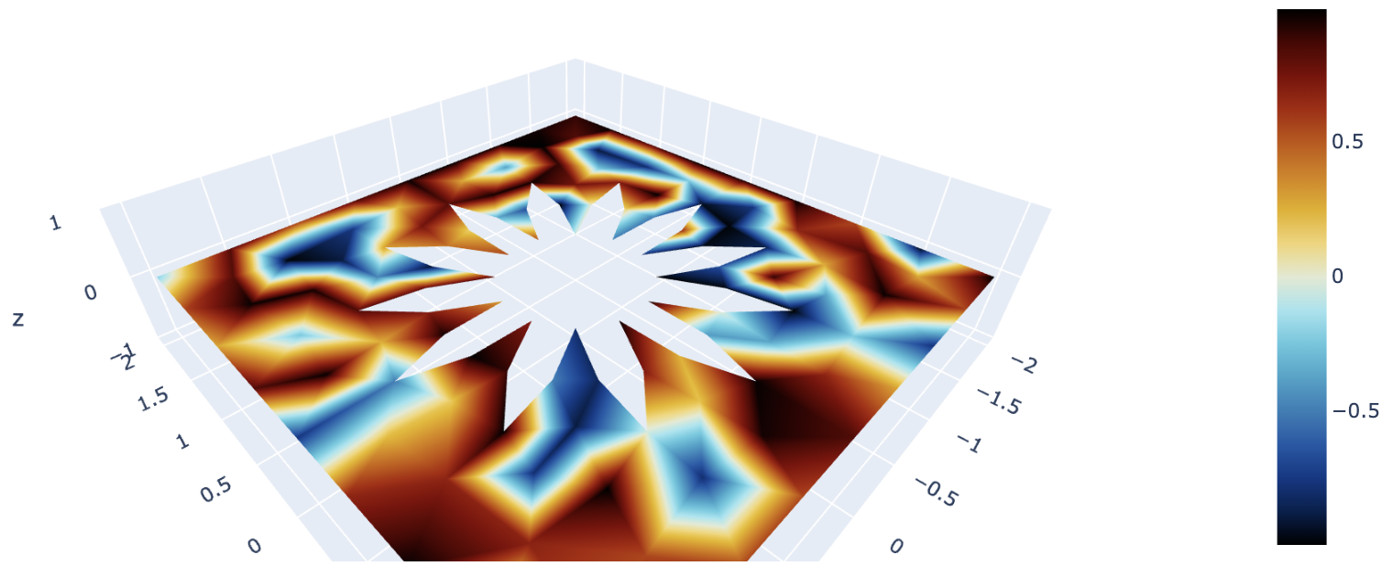
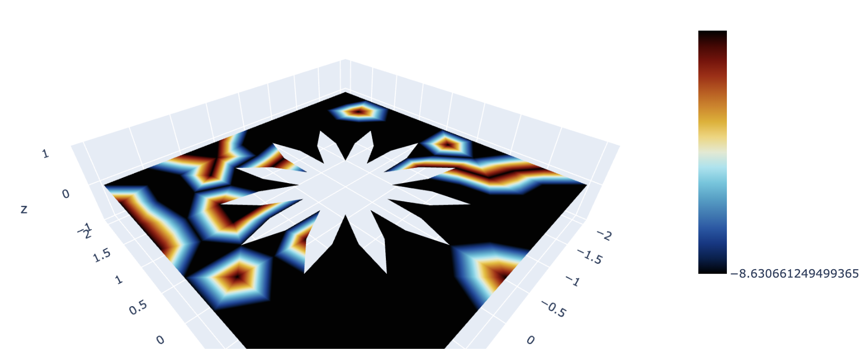
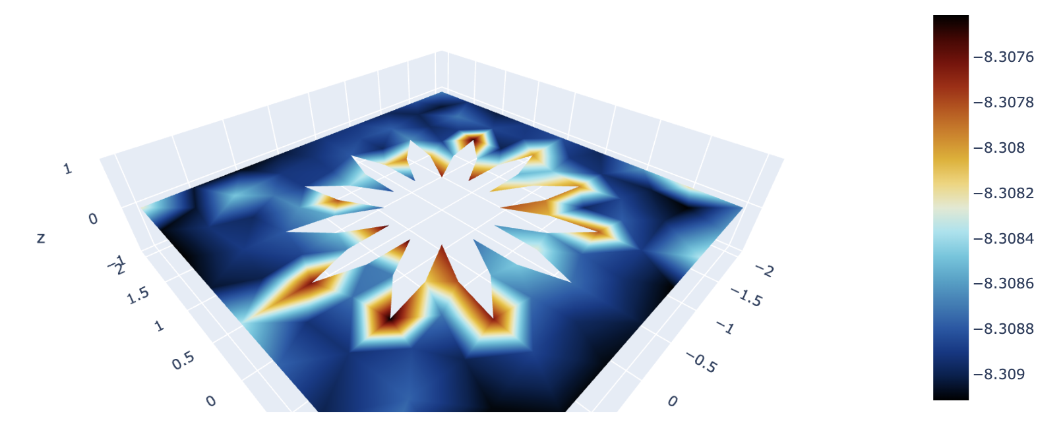
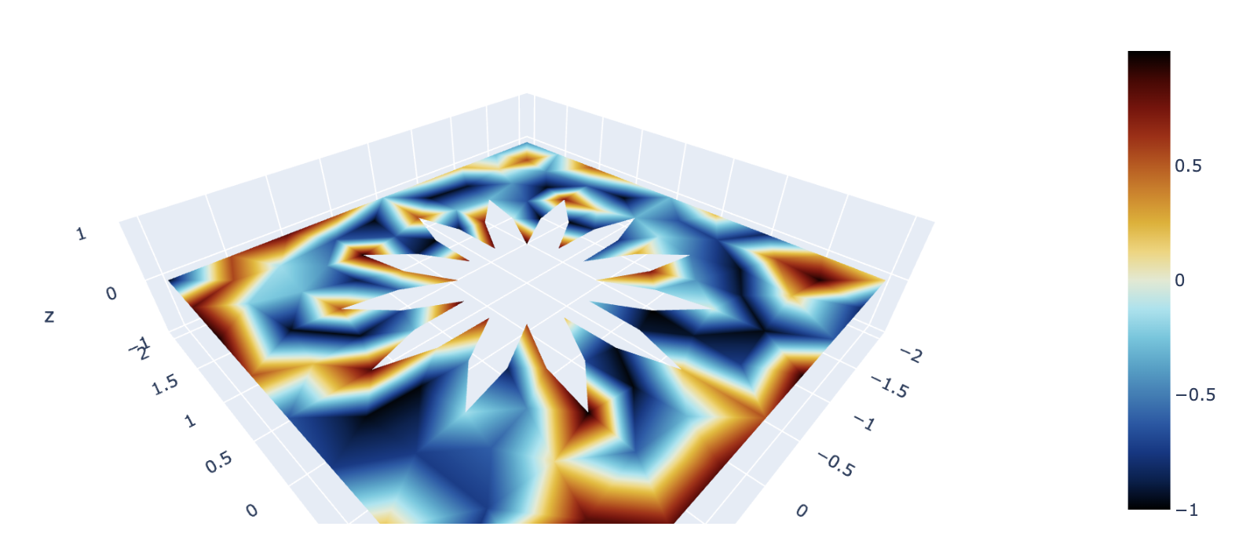
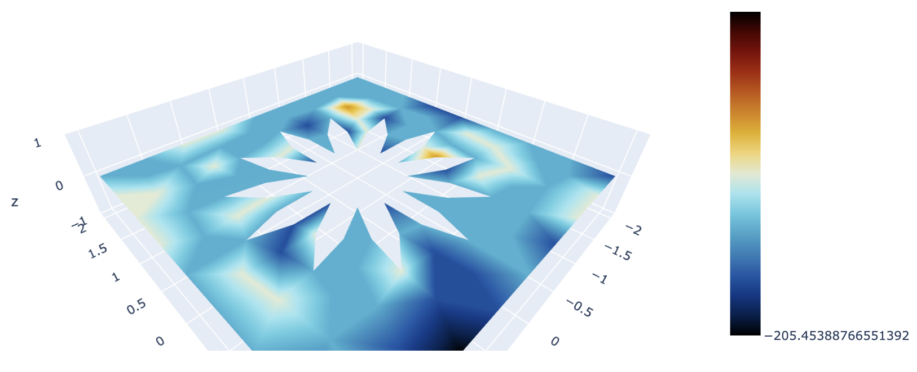
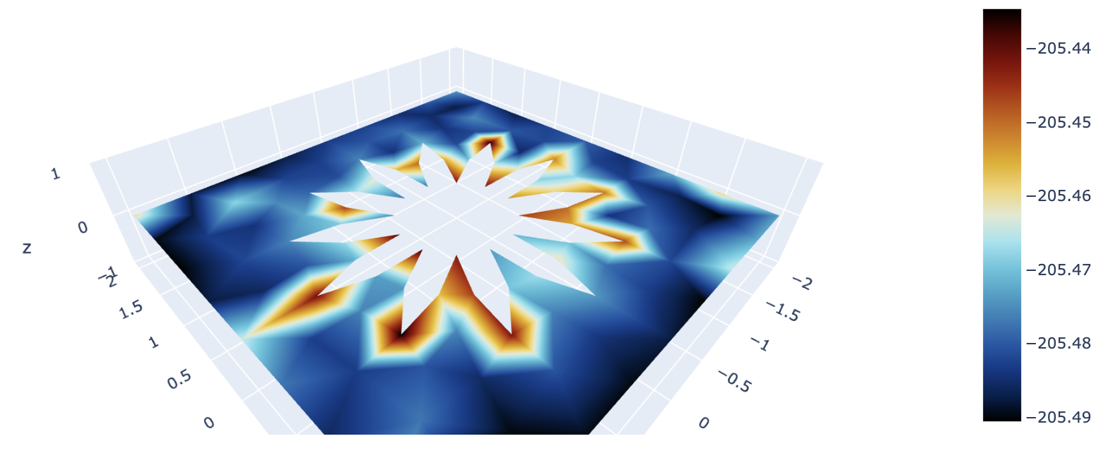


Final solution for different parameters
$$D_{u}=1, { D}_{v}=1.75$$
$$D_{u}=0.0023, { D}_{v}=0.0045$$
Initial solution u
Initial solution u
Final solution u
Final solution u
Initial solution v
Initial solution v
Final solution v
Final solution v

Slide 2
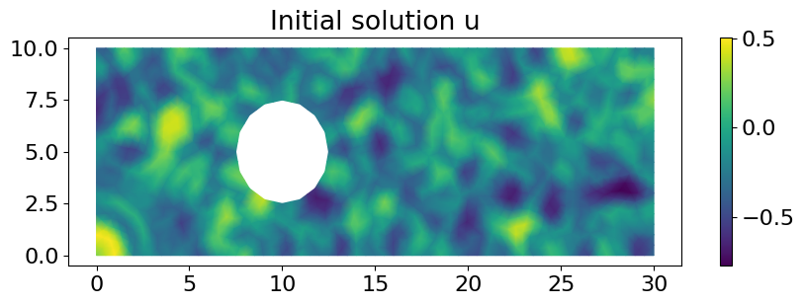
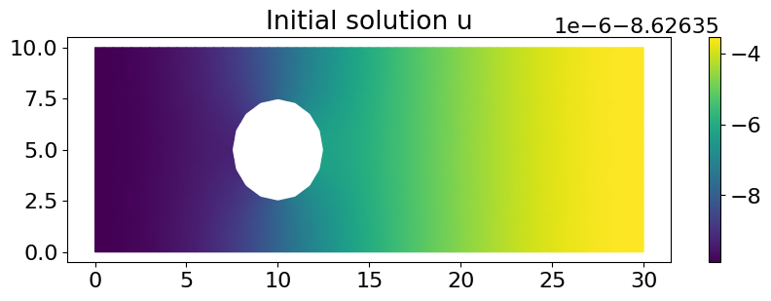
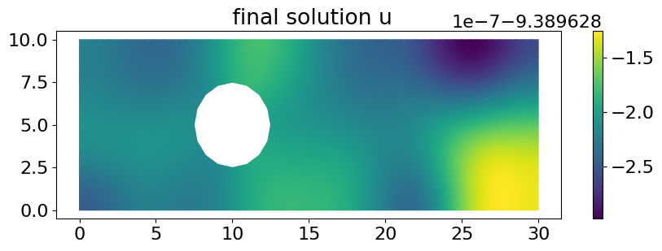
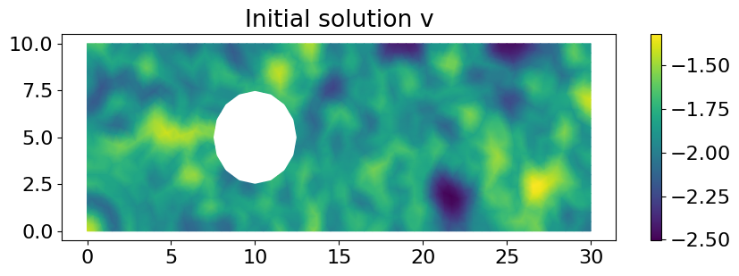
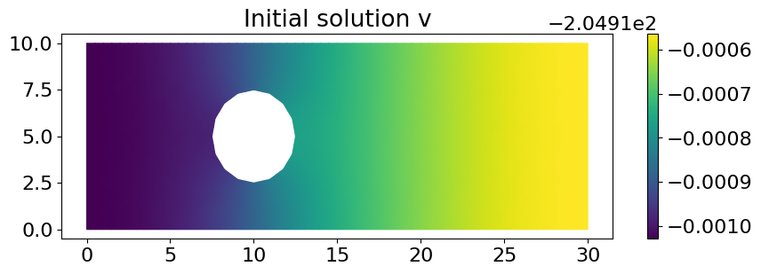
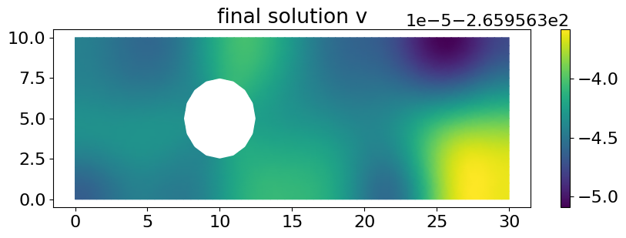


Final solution for different parameters
$$D_{u}=1, { D}_{v}=1.75$$
$$D_{u}=0.0023, { D}_{v}=0.0045$$

Slide 3
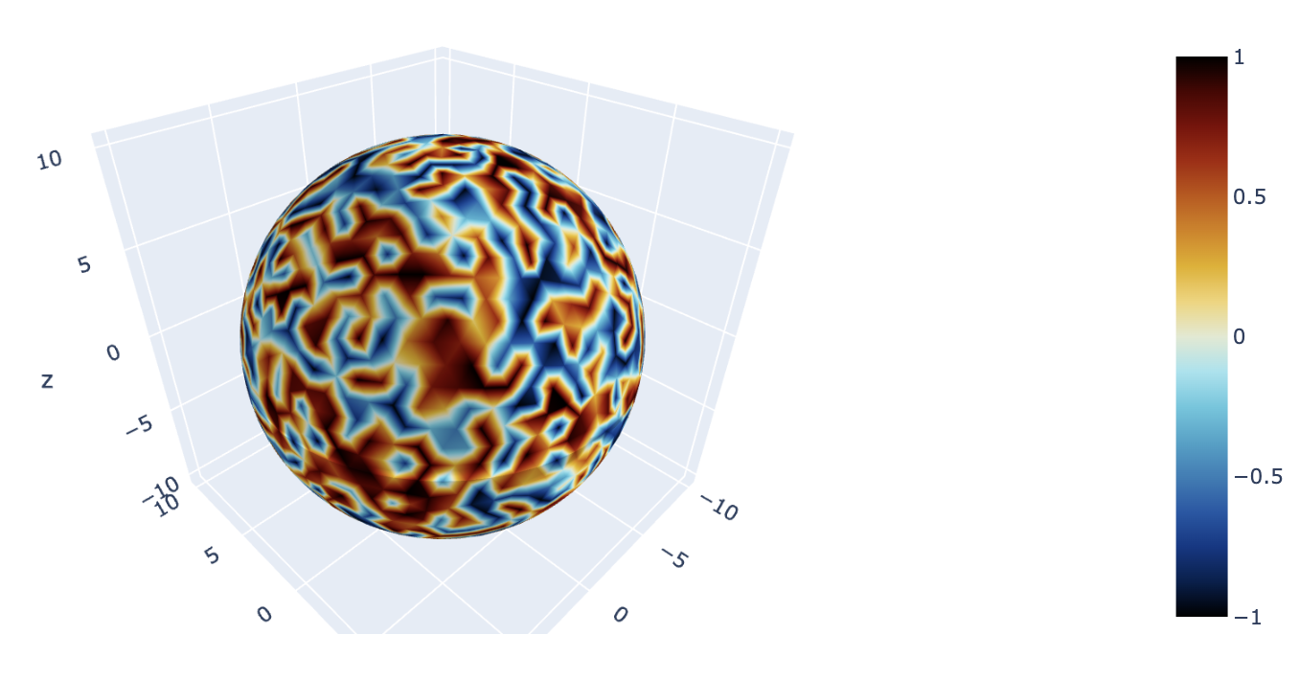
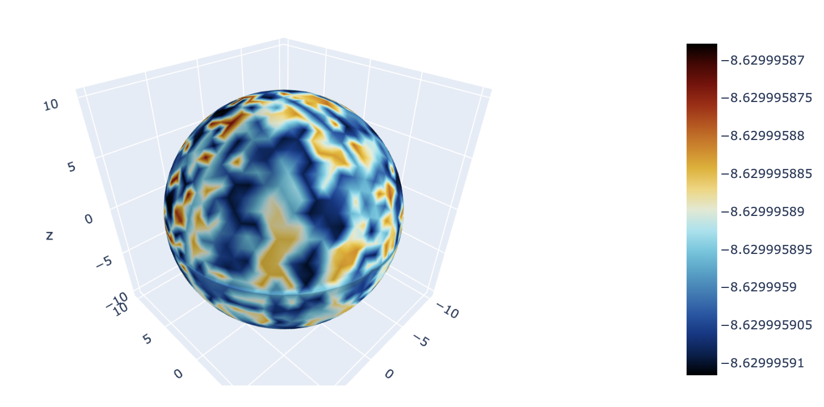
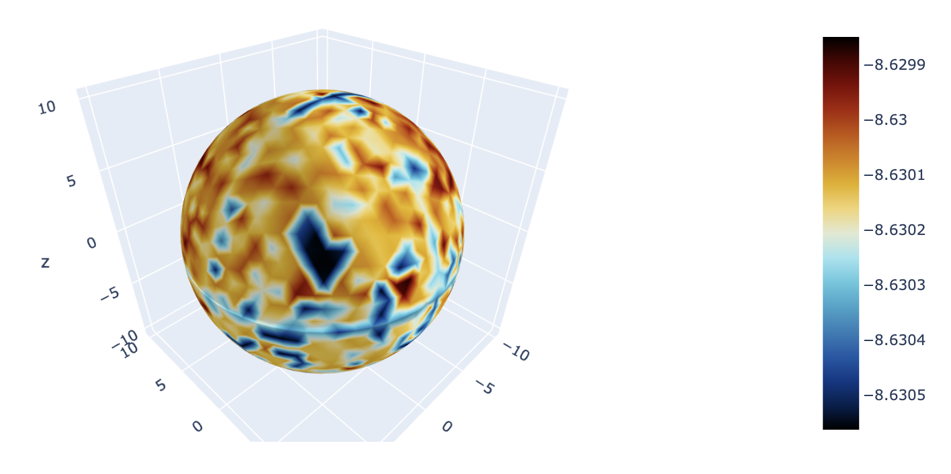
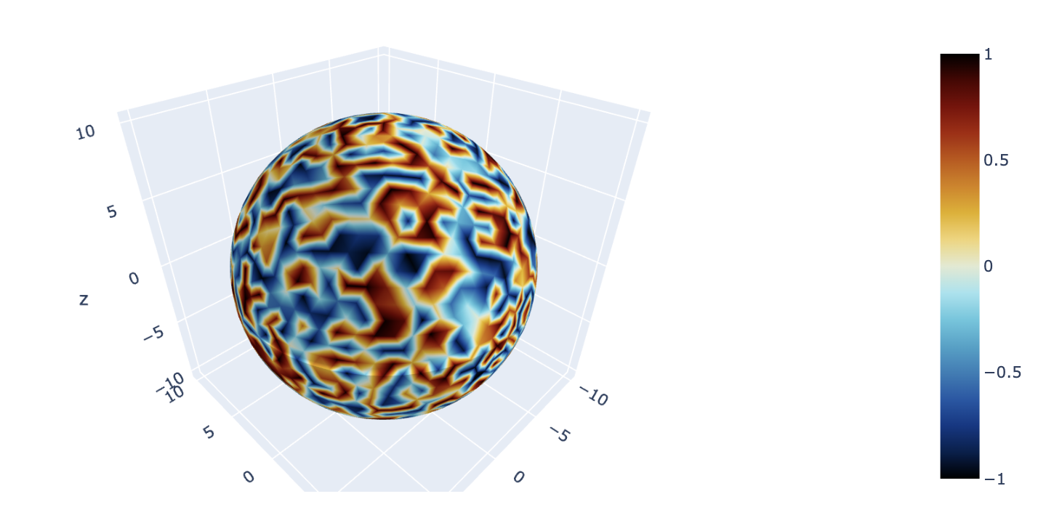
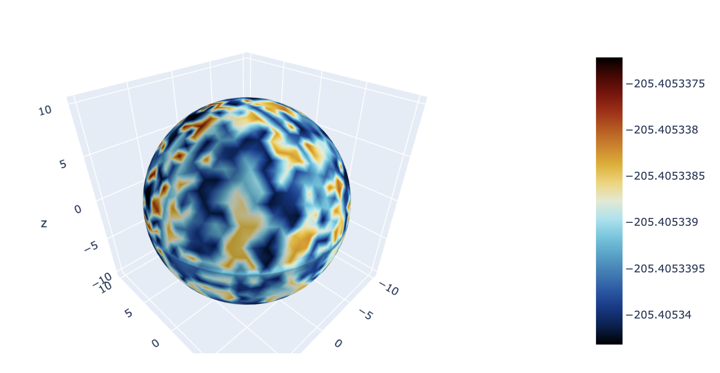
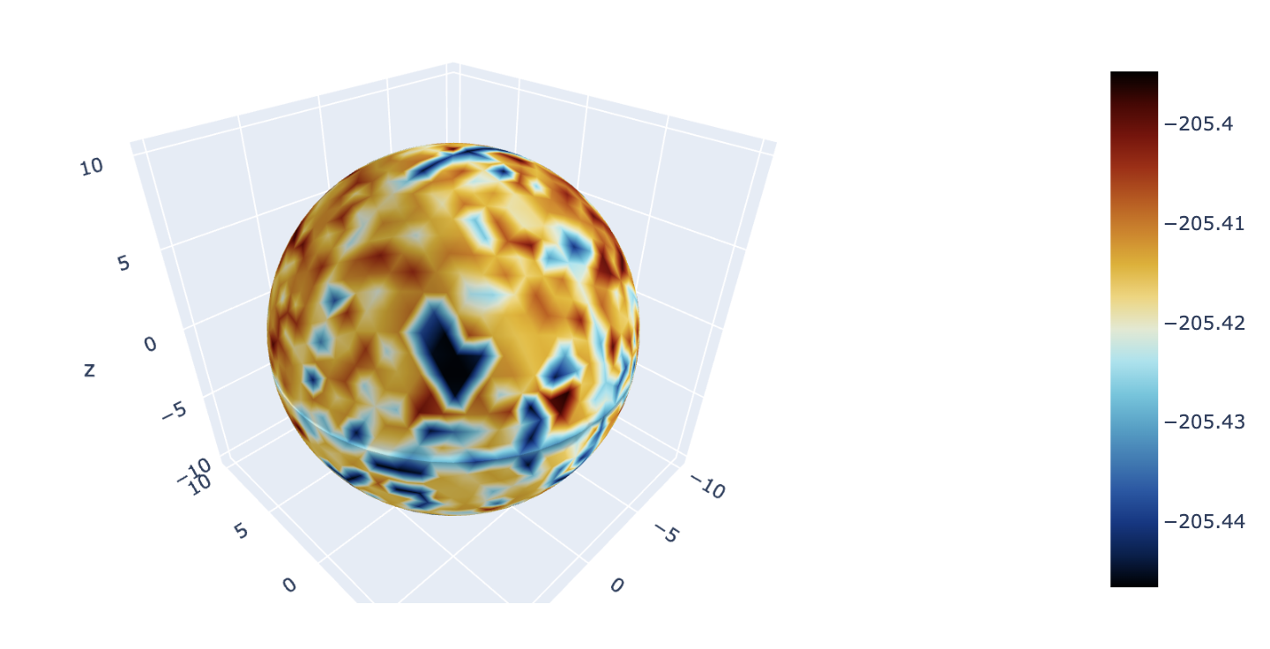
Final solution for different parameters
$$D_{u}=1, { D}_{v}=1.75$$
$$D_{u}=0.0023, { D}_{v}=0.0045$$
Initial solution u
Initial solution u
Final solution u
Final solution u
Initial solution v
Initial solution v
Final solution v
Final solution v

Slide 4
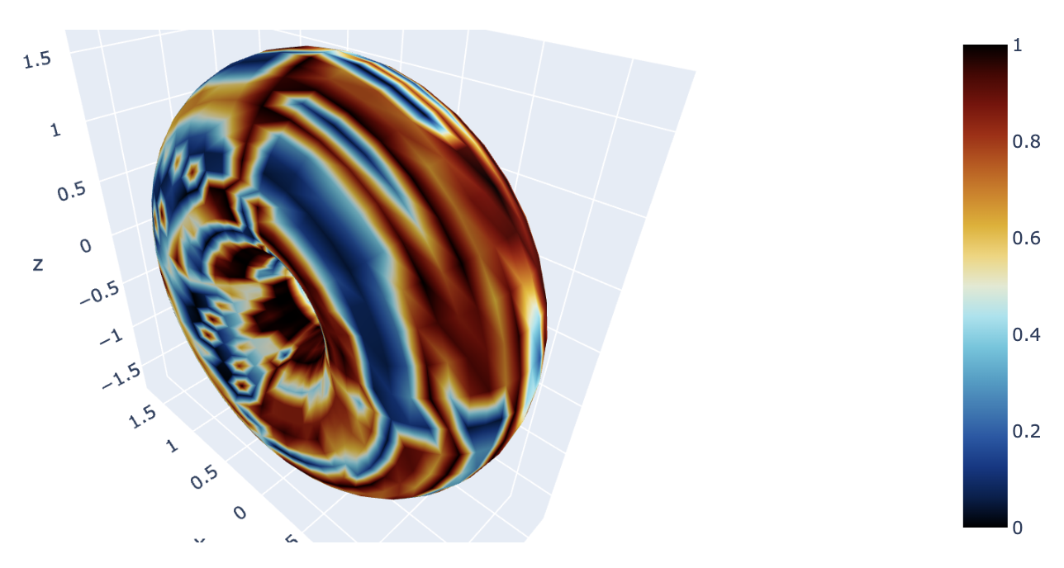
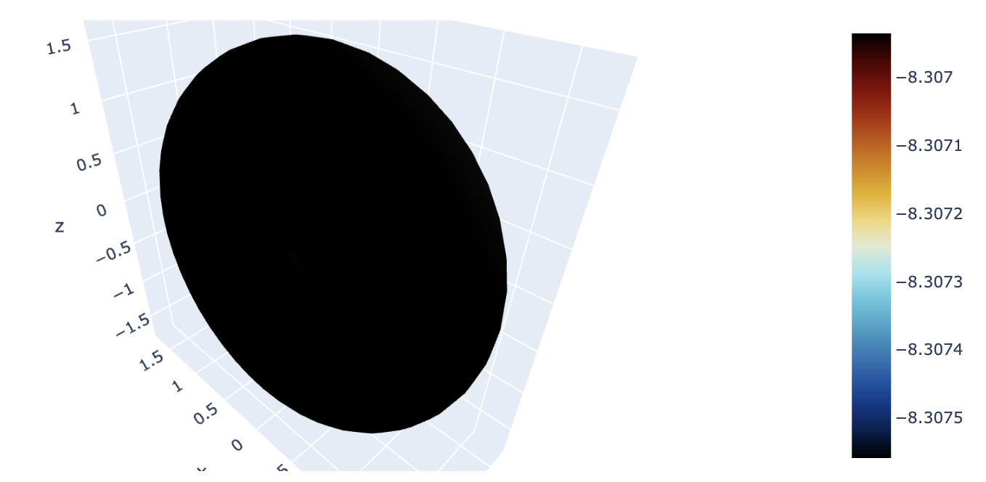
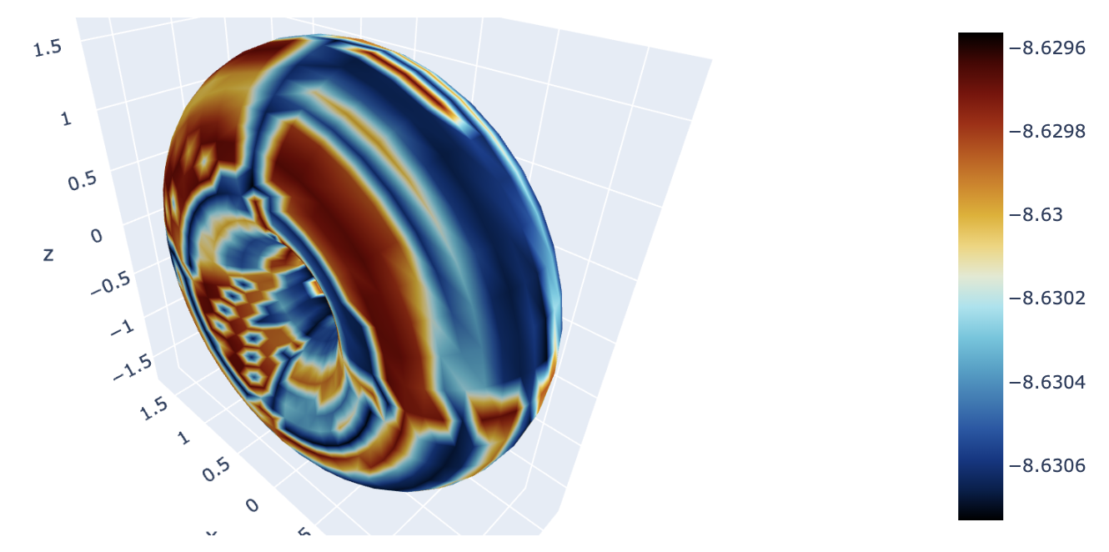
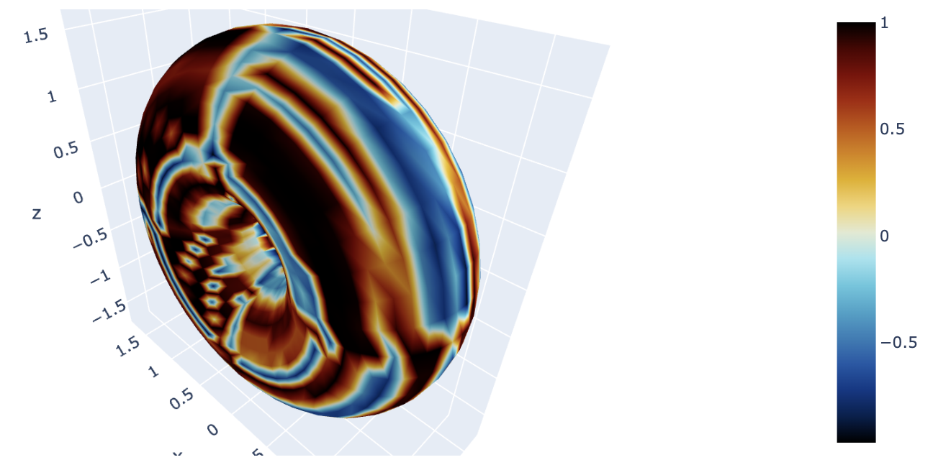

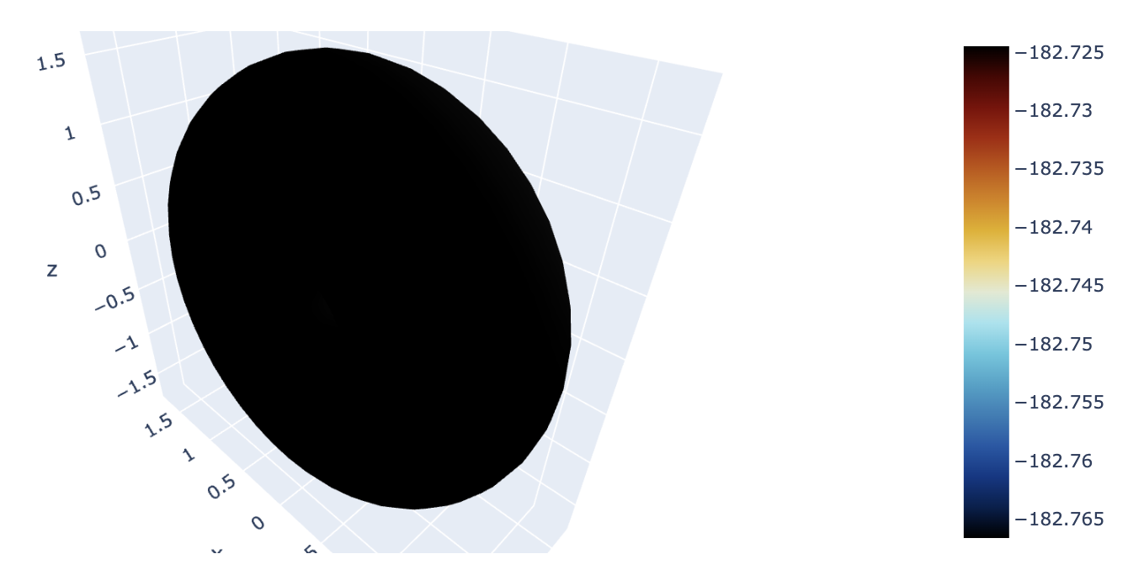
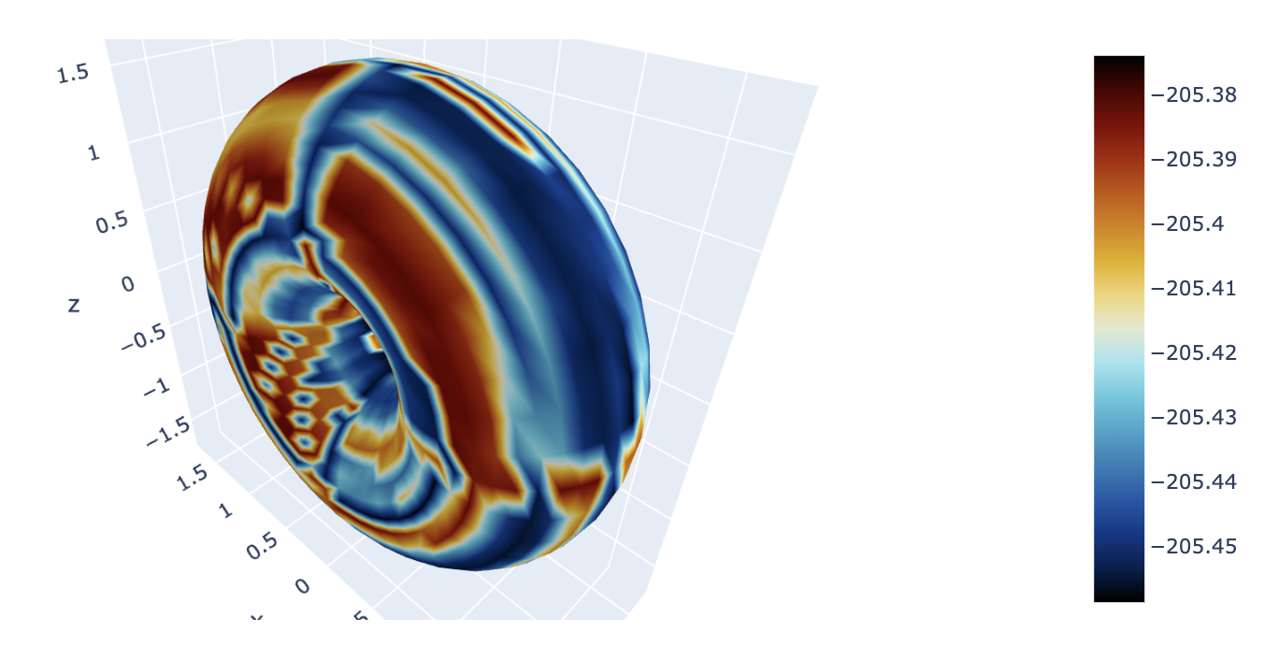

Final solution for different parameters
$$D_{u}=1, { D}_{v}=1.75$$
$$D_{u}=0.0023, { D}_{v}=0.0045$$
Initial solution u
Initial solution u
Final solution u
Final solution u
Initial solution v
Initial solution v
Final solution v
Final solution v

